Slide 1


PRESENTED TO: DOCSE
A Movie Recommendation System:
MOVIE MAESTRO
I YEAR II SEMESTER PROJECT DEFENSE
Computer Engineering (2023)

Slide 2

Group Members
Aditya Pokharel
Abhiyan Regmi
Roll no.: 32
Roll no.: 42
Sameer Kumar Sah
Parikchit Sen
Roll no.: 43
Roll no.: 45
Project Supervisor: Mr. Suman Shrestha

Slide 3

What is Movie Maestro?
Movie: a recording of moving images that tells a story and that people watch on a screen or television
Maestro: a distinguished figure in any sphere
In literal sense, Movie Maestro is something that is distinguished from others for its own style
So, our project “Movie Maestro” is an application dedicated to bring unique recommendation of movies to its users

Slide 4

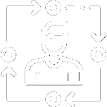


Why Movie Maestro?
User Friendly Experience
Personalized Recommendation
Interactivity with the user
Simple and Light Tool
4

Slide 5



Overview of the Project
1
2
3
Team work division
Divided the specific work to each member of the group to work accordingly in different aspect of the project at the same time for efficiency
Setting up Git
Git was used as the version control system to properly configure the development environment and ensure effective collaboration
Development
C++ was used as the programming language for the development in QT framework and Sqlite3 as the serverless database
5

Slide 6


Problem to be addressed
User Engagement Decline
Data Security Risks
Genre Selection Limitations
Created to address this issue by developing an intelligent personalized recommendation system that suggests movies based on user preferences, increasing user engagement and satisfaction
Developed with the aim to improve data security by encryption of data and prevention of SQL injection
Build to address the issue of limiting the recommendation system due to static genre selection system
6

Slide 7



Objectives
1
2
3
To create a simple and reliable desktop application
To recommend movies that meet the expectations of different users
To efficiently store and retrieve user data and movie information
7

Slide 8




Design and Implementation
Research
Development
Project Setup
Testing
8

Slide 9



System Requirements
Software Specifications
Operating System: Windows
Development Environment: QT Creator
Database: SQLite3
Programming Language:
C++
9

Slide 10
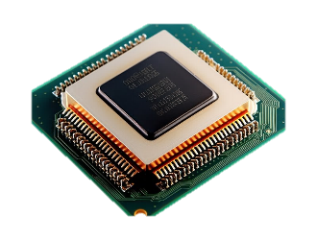

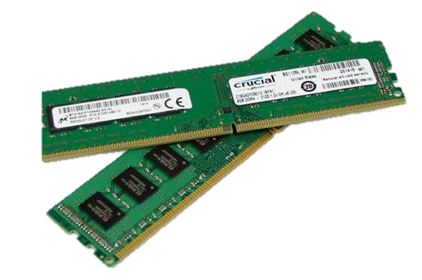
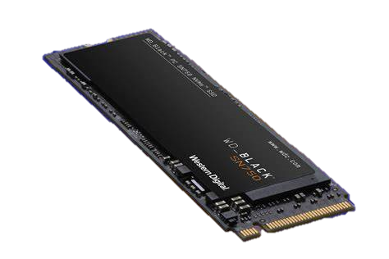
System Requirements
Hardware Specifications
Processor: Intel Core i5 12500H
Graphics:
Integrated Graphics
RAM: 8 GB
Storage:
512 GB SSD
10

Slide 11
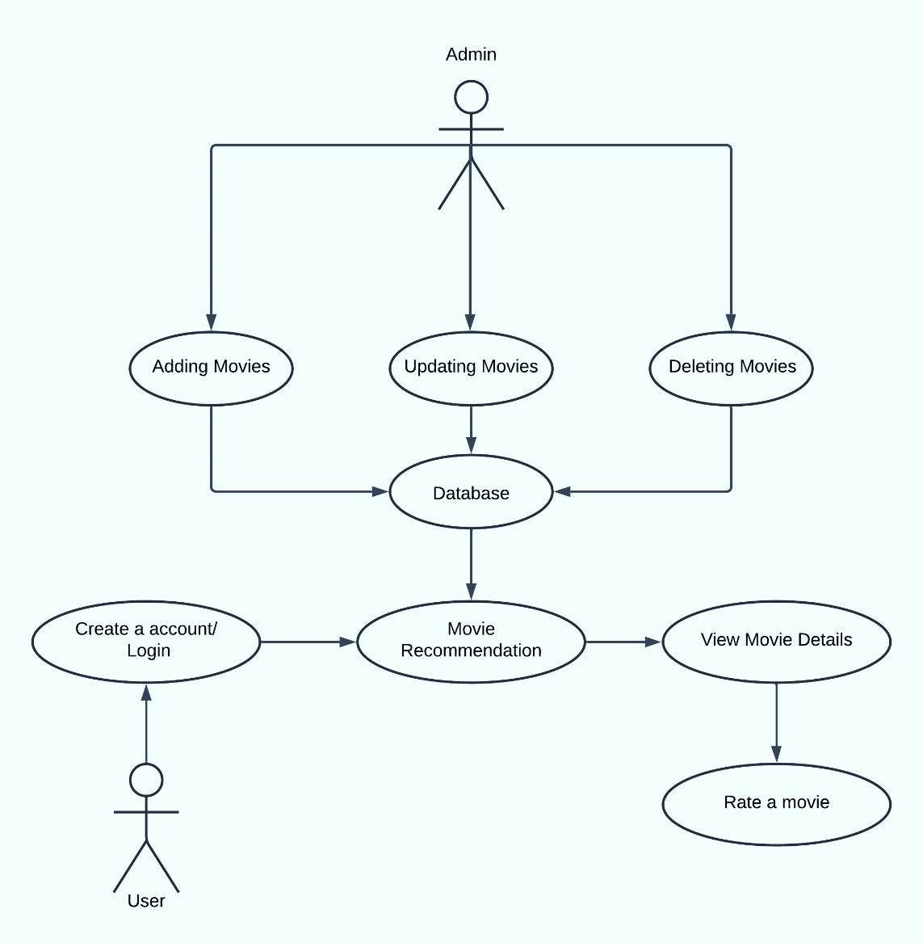
Use-Case Diagram
11

Slide 12
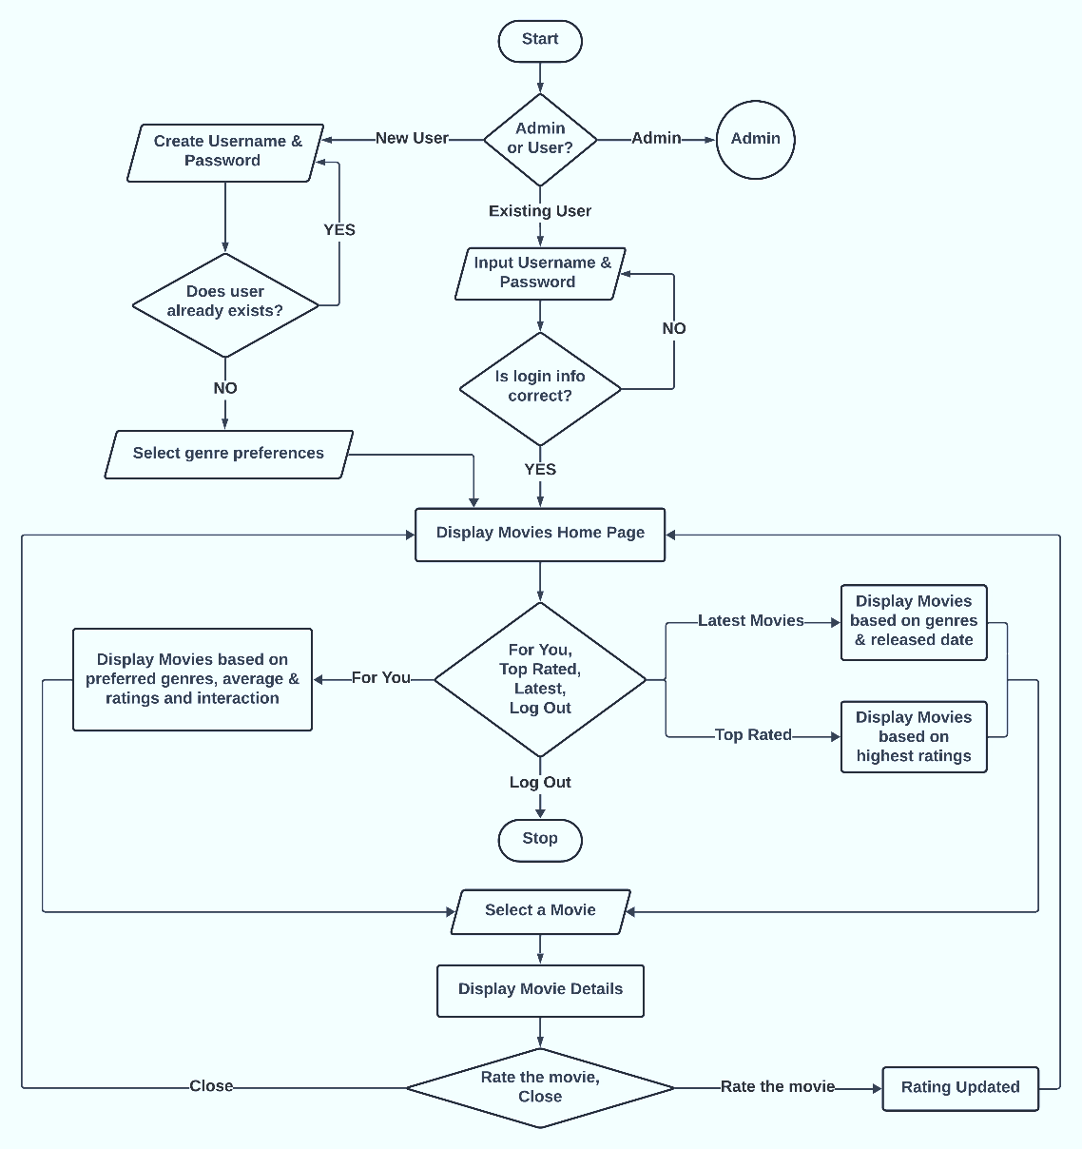
Flowchart: User
12

Slide 13
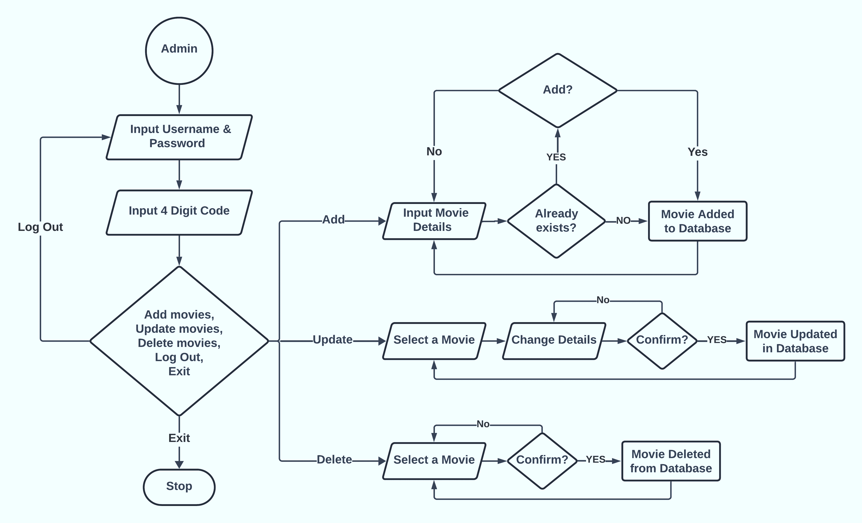
Flowchart: Admin
13

Slide 14
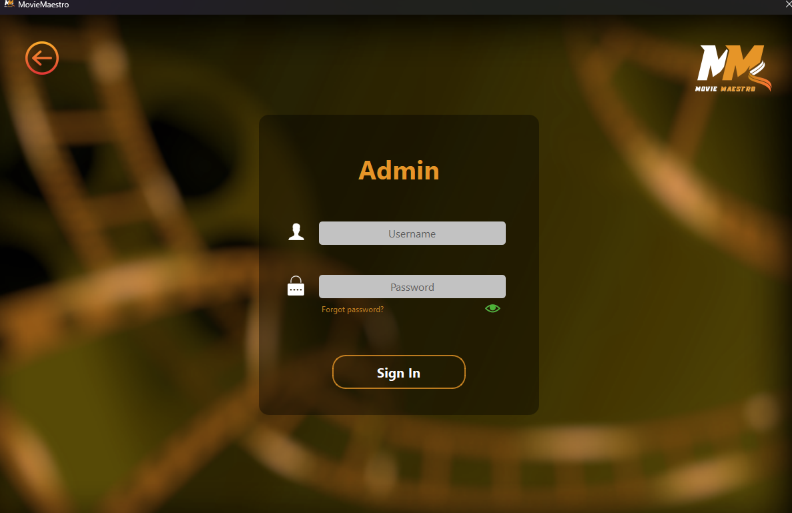
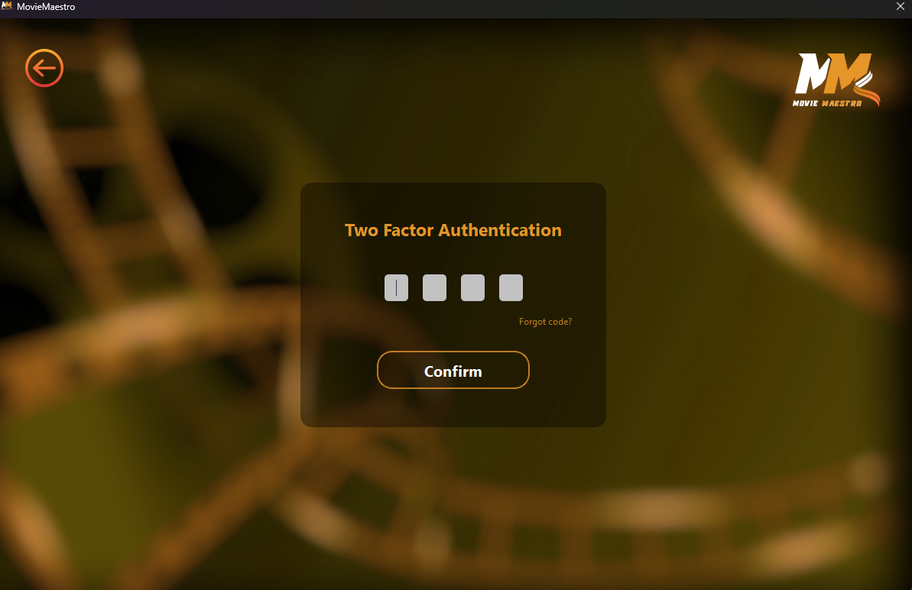
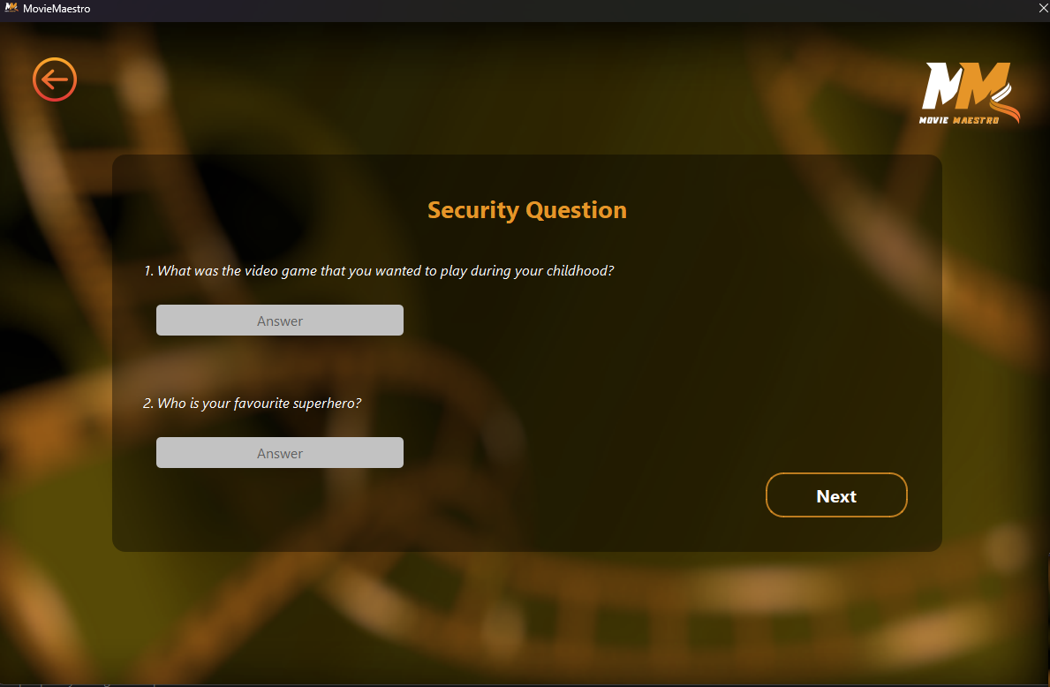
Working Mechanism
Admin Panel: Credentials
Login
Two factor authentication
Security Questions
14

Slide 15
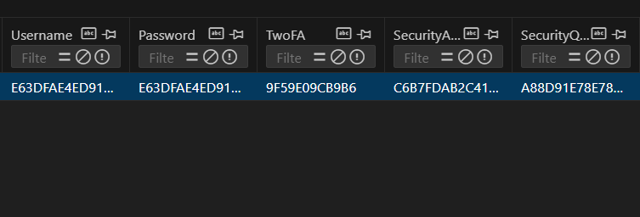
Working Mechanism
Admin Panel: Credentials
Storing Admin Credentials using Obfuscation Method
Secured in database
15

Slide 16
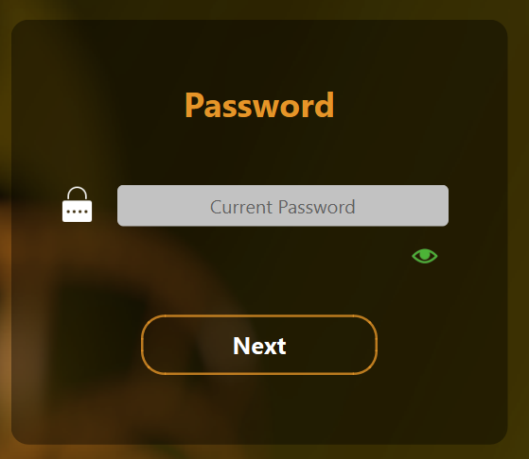
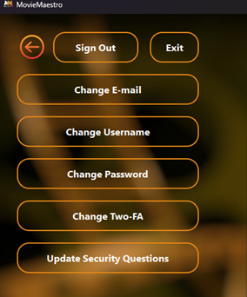
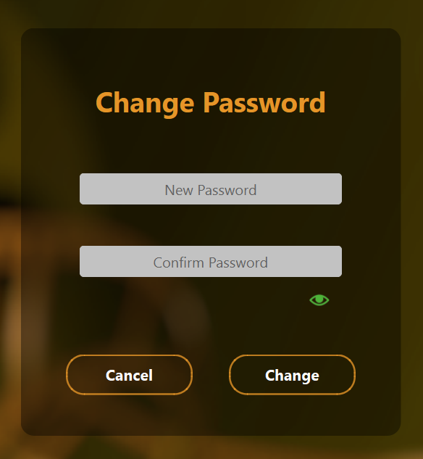
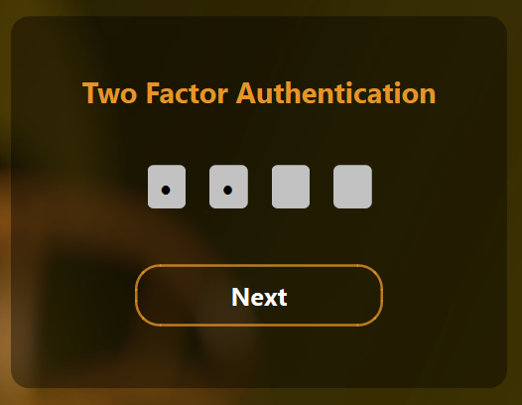
Working Mechanism
Admin Panel: Credentials
Options
Changing Password
16

Slide 17
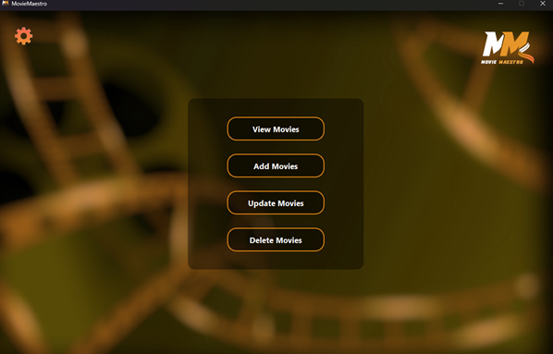
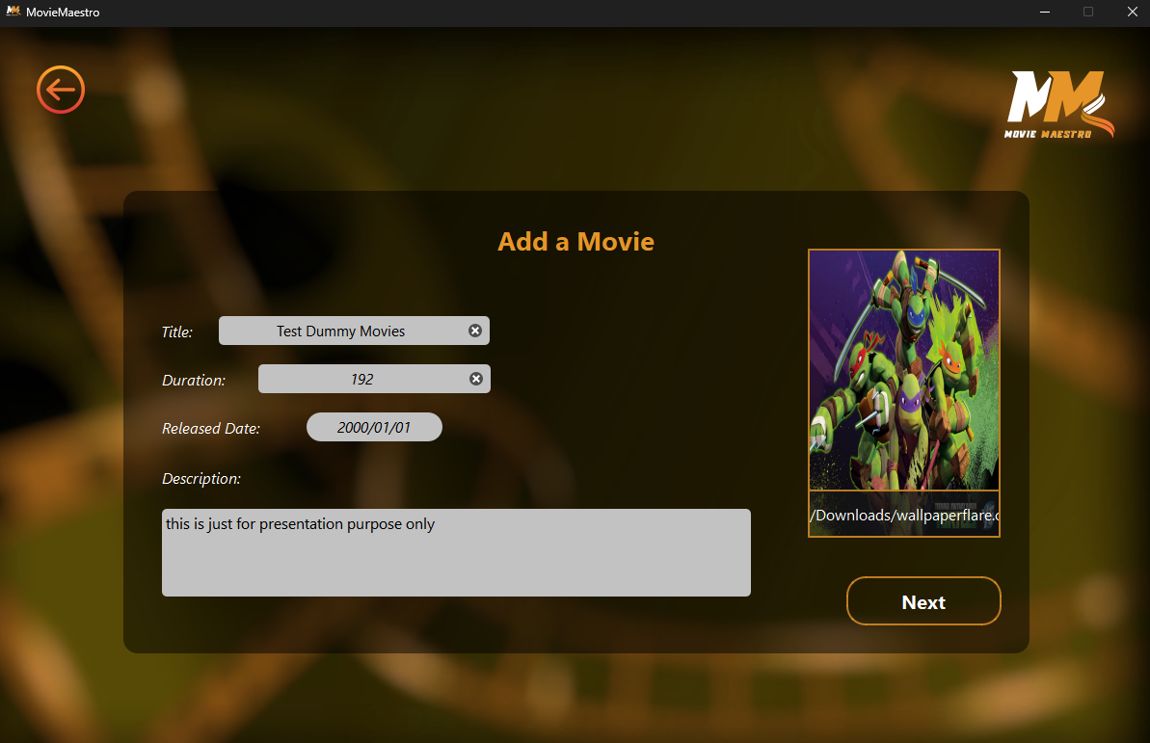
Working Mechanism
Admin Panel: Movie Organization
Options
Add Movies
17

Slide 18
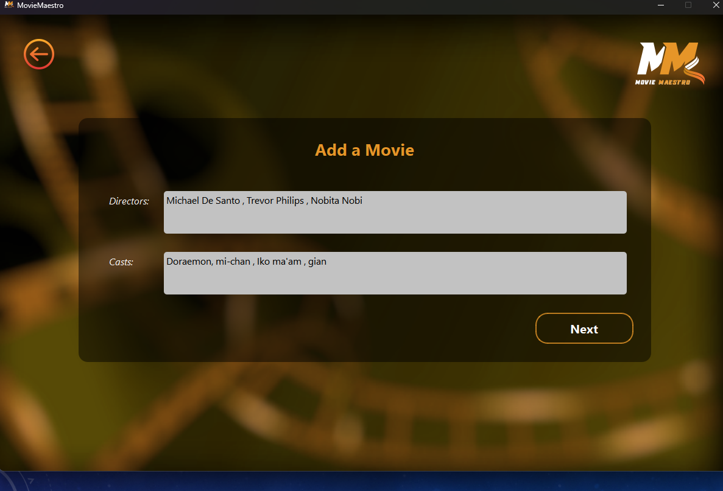
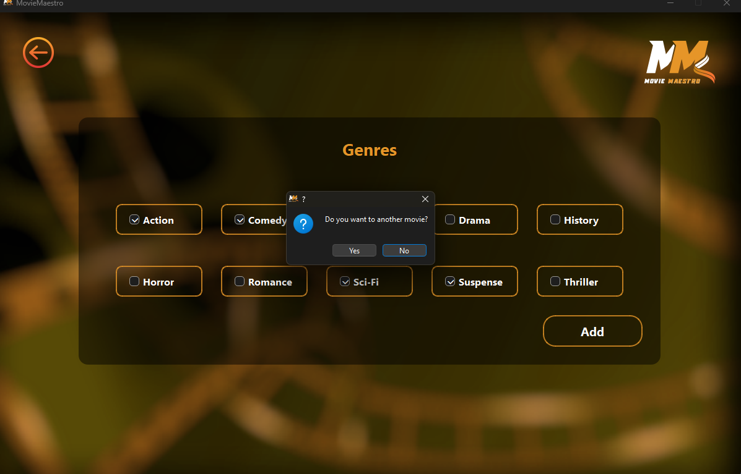
Working Mechanism
Admin Panel: Movie Organization
Fill details
Select Genres
18

Slide 19
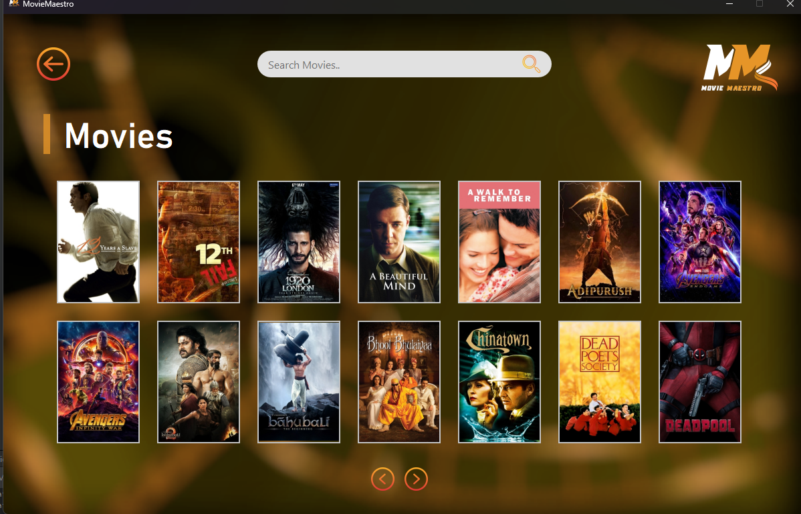
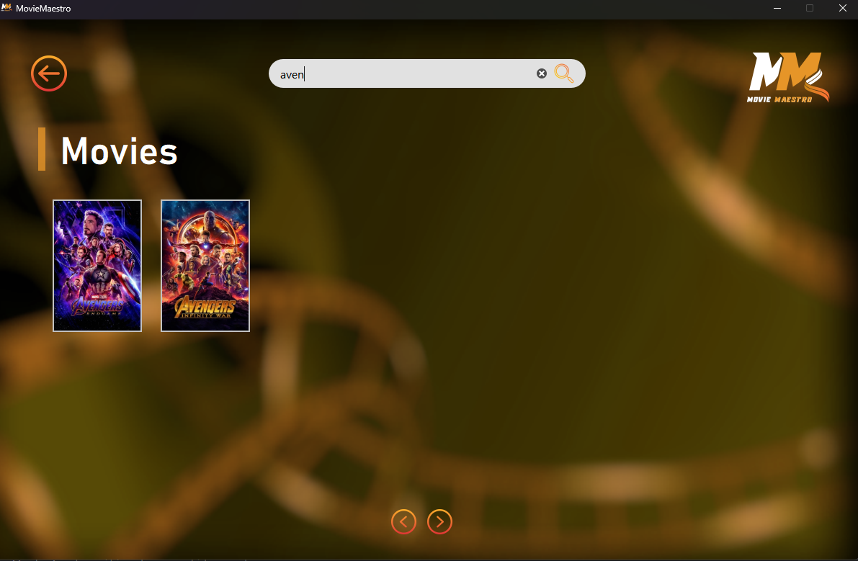
Working Mechanism
Admin Panel: Movie Organization
View Movies
Search Movies
19

Slide 20
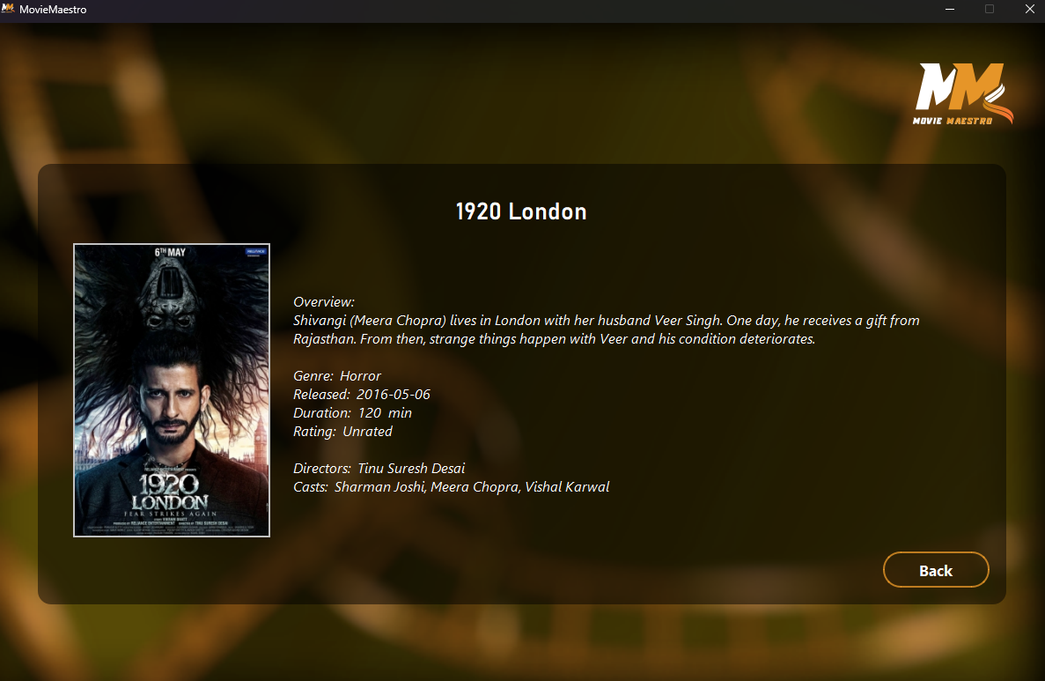
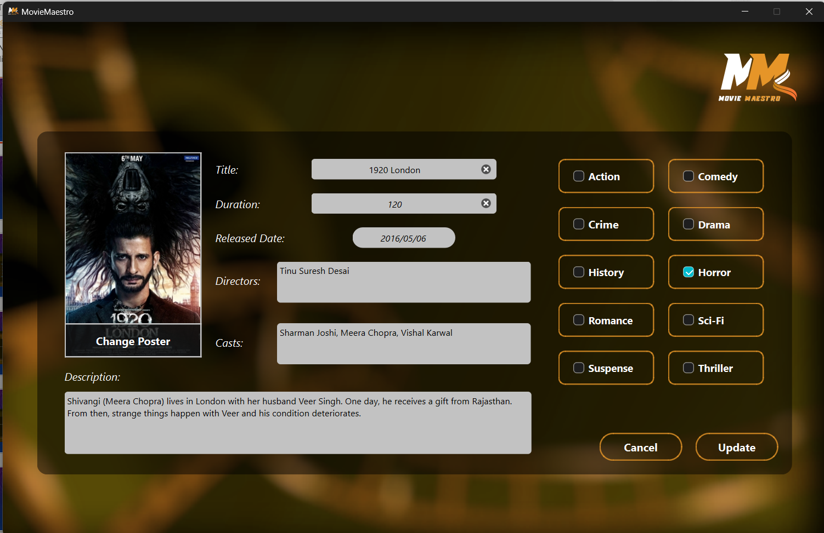
Working Mechanism
Admin Panel: Movie Organization
View Movie Information
Update Movie Information
20

Slide 21
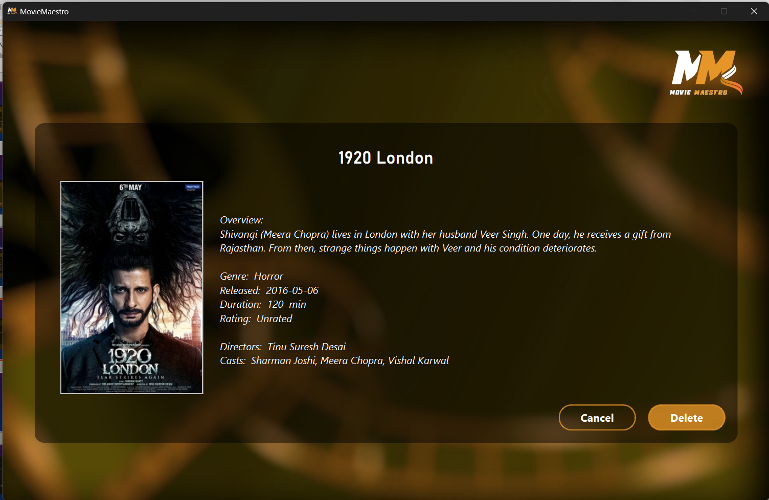
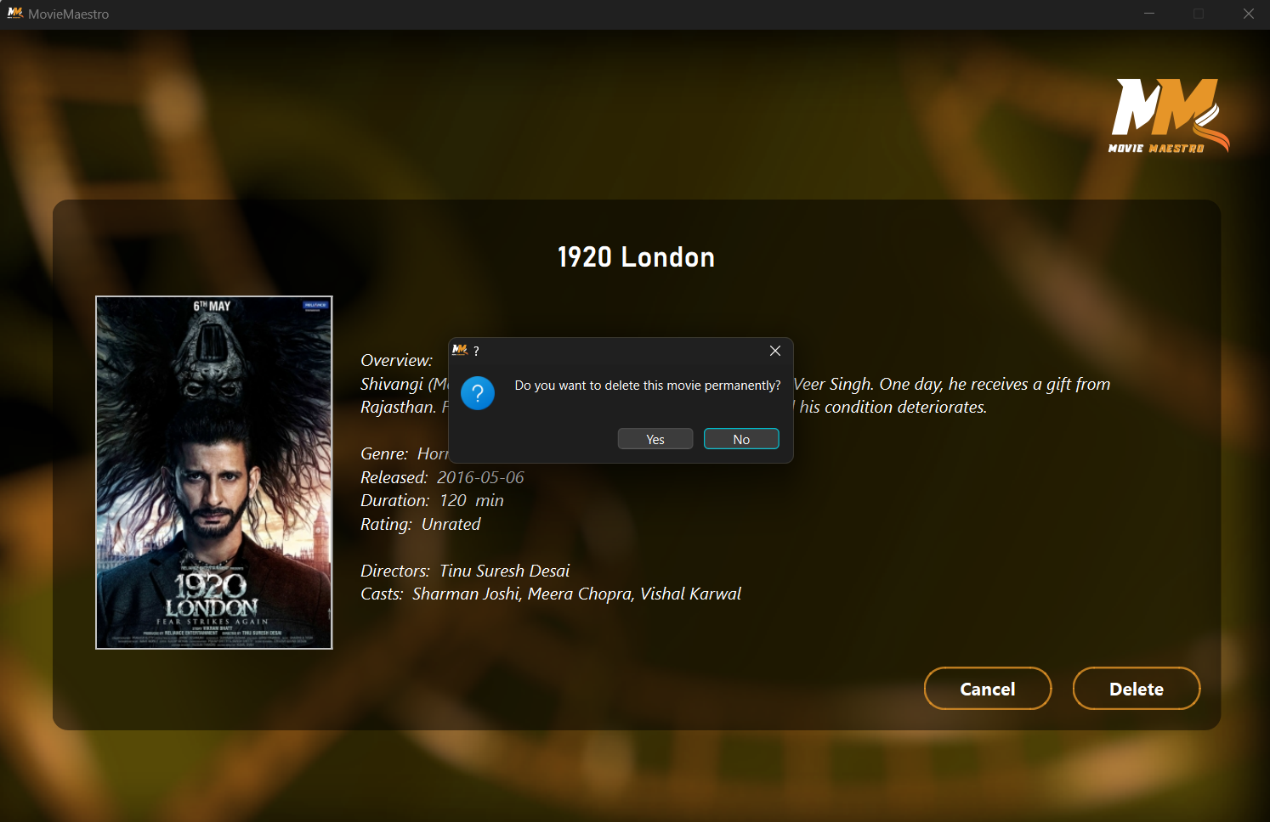
Working Mechanism
Admin Panel: Movie Organization
Delete Movie
Confirm to Delete Movie
21

Slide 22
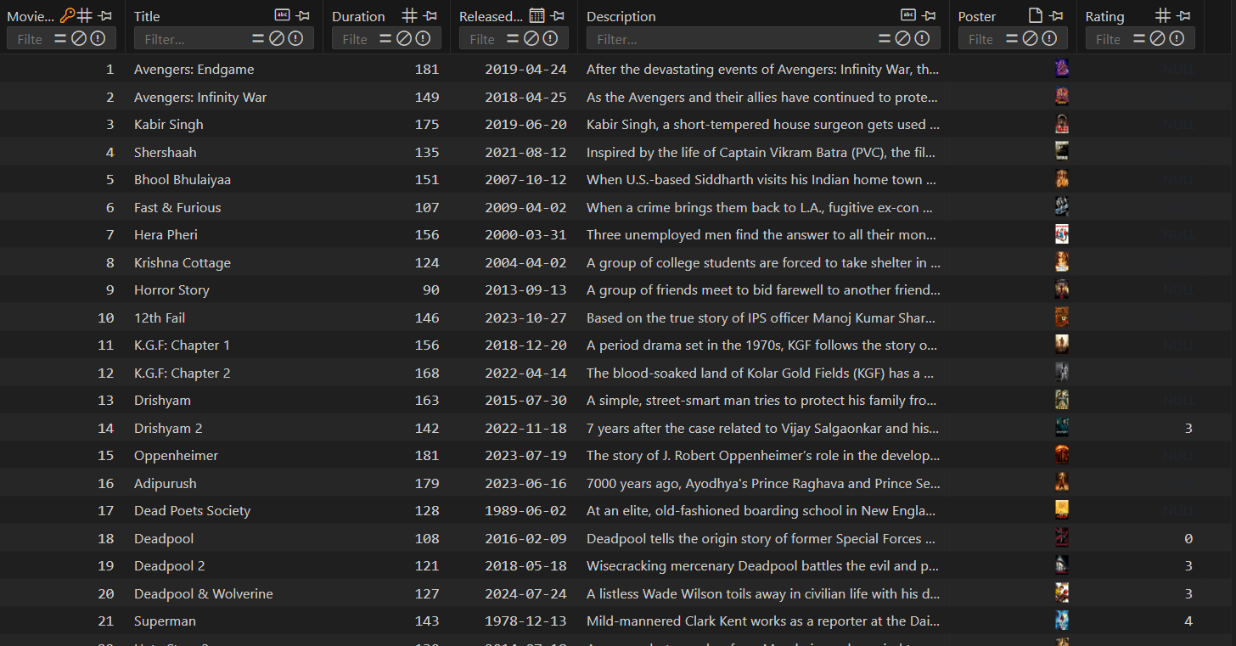
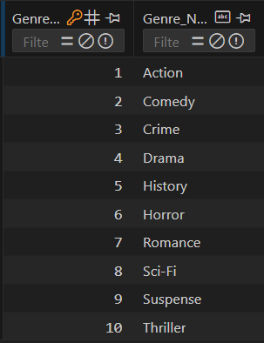
Working Mechanism
Movies Database
Movies Table
Genres Table
22

Slide 23
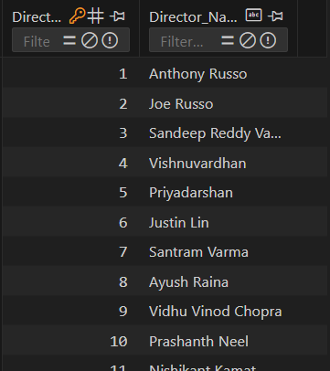
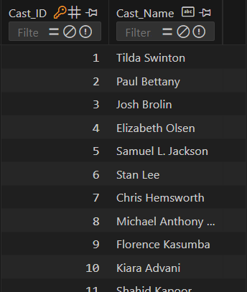
Working Mechanism
Movies Database
Directors Table
Casts Table
23

Slide 24
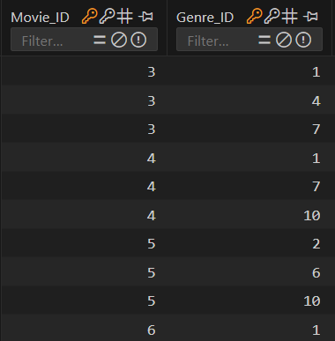
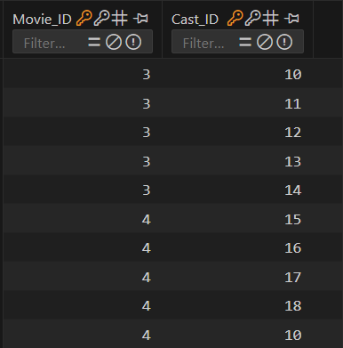
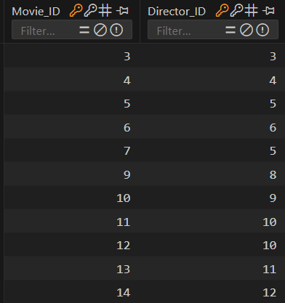
Working Mechanism
Movies Database
Junction Tables relating Movie_ID with Genre_ID, Cast_ID & Director_ID
24

Slide 25
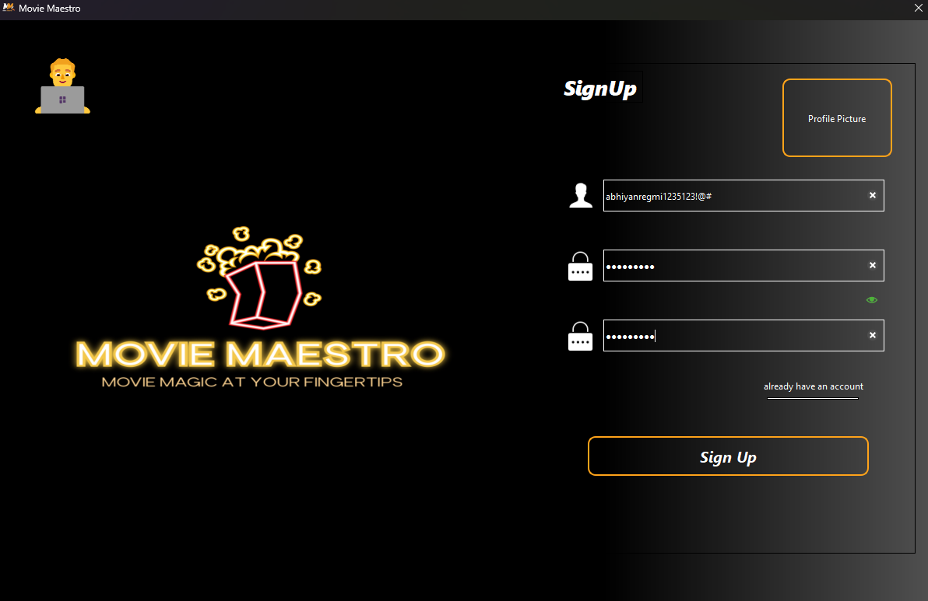
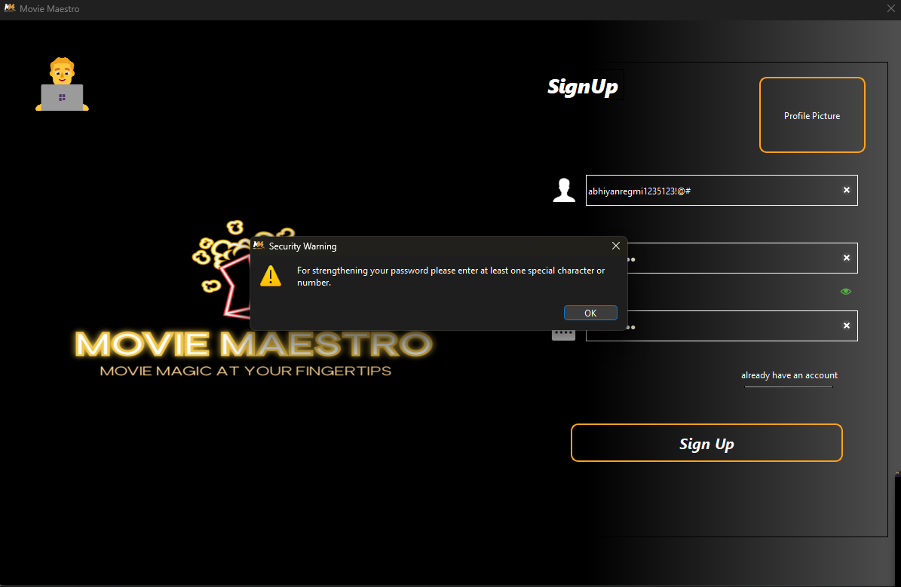
Working Mechanism
User Panel: Credentials
Sign Up
Validations
25

Slide 26
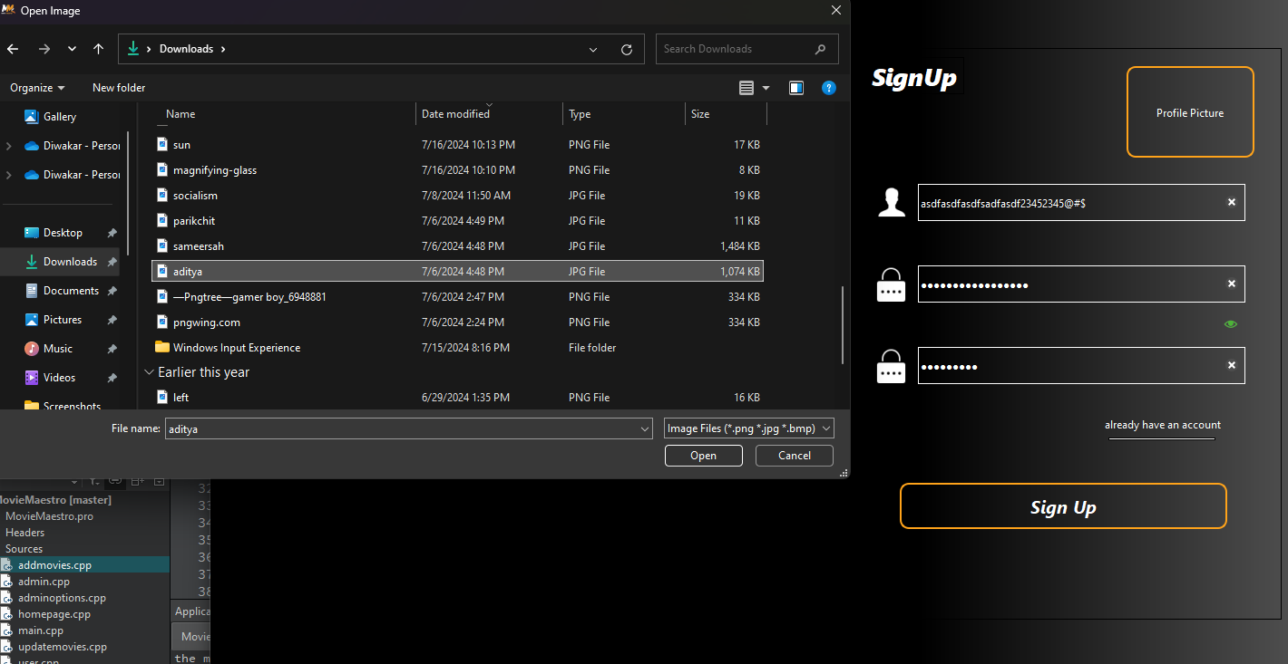
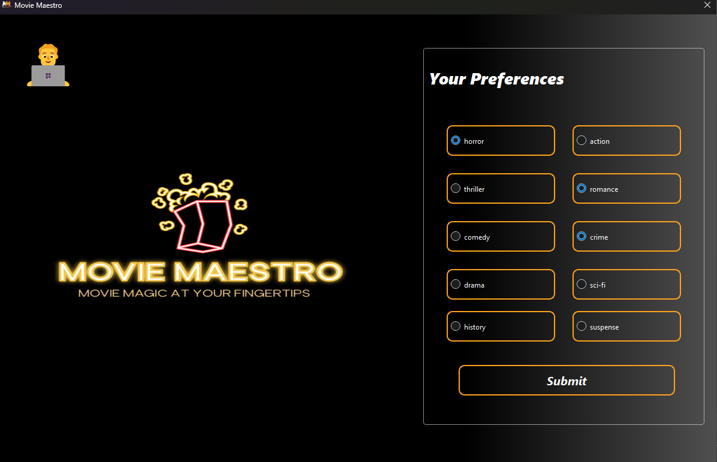
Working Mechanism
User Panel: Credentials
Optional Profile Picture
Genre Selection
26

Slide 27
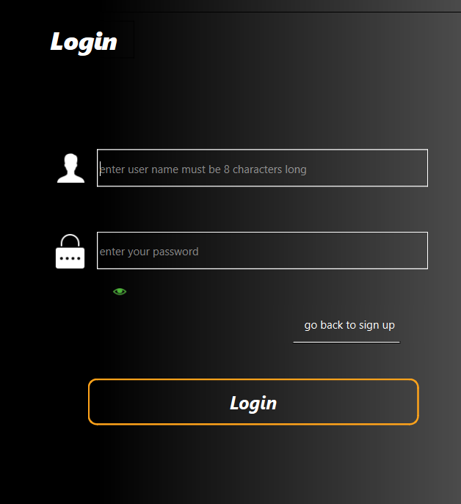
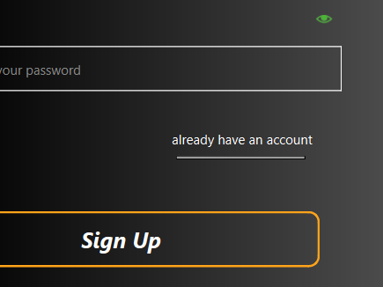
Working Mechanism
User Panel: Credentials
Login
27

Slide 28
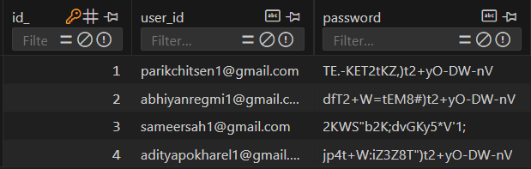
Working Mechanism
User Panel: Credentials
Hill Cipher Encryption
Secured in database
28

Slide 29
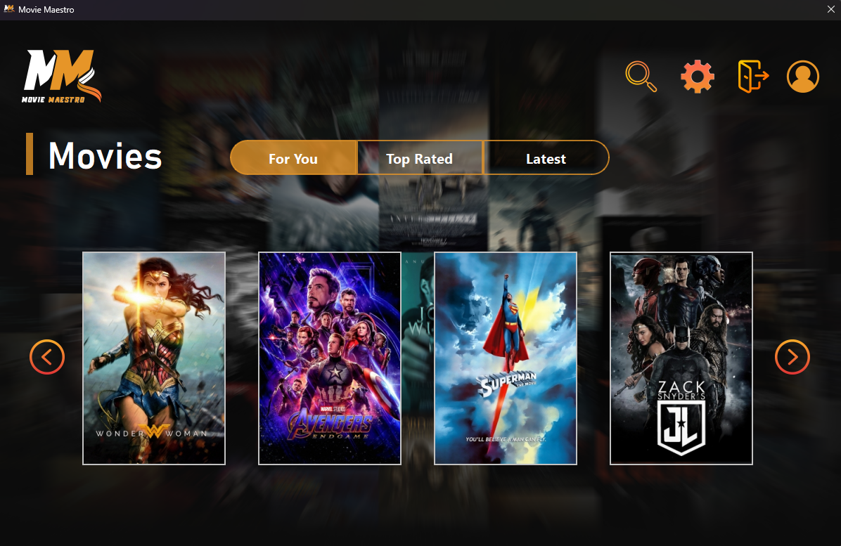
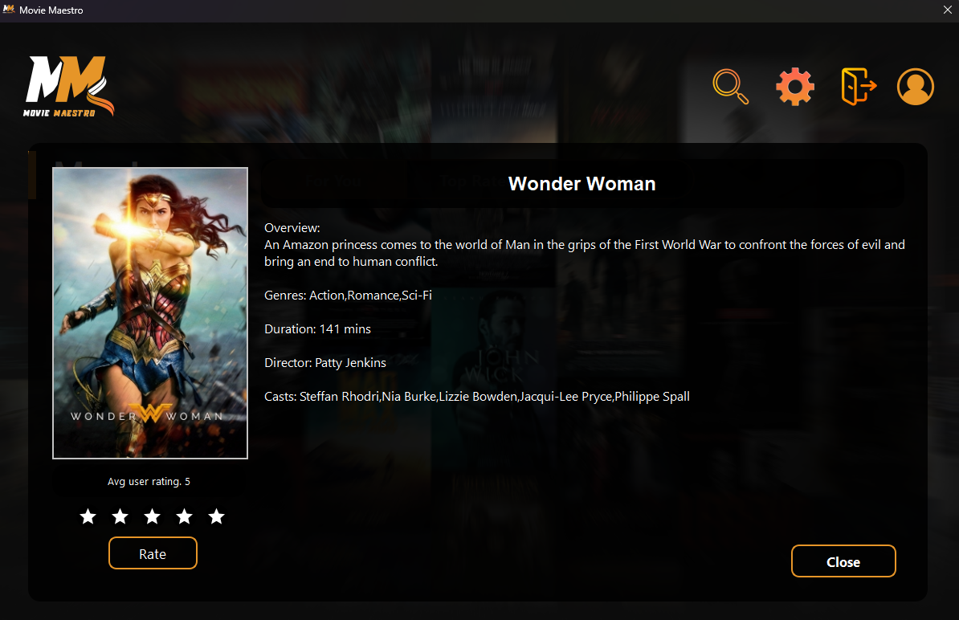
Working Mechanism
User Panel: Homepage
For You
View Movie Information
29

Slide 30
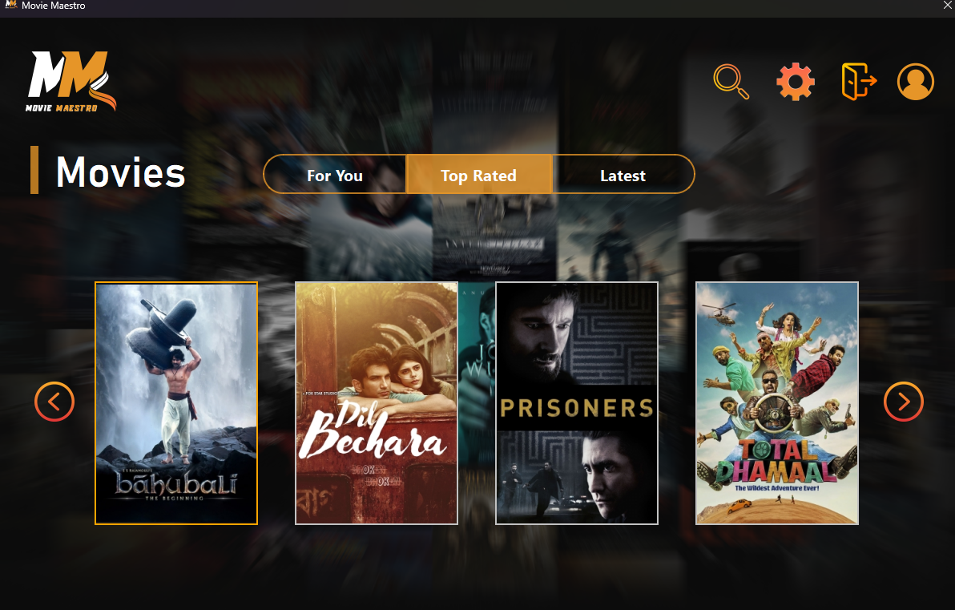
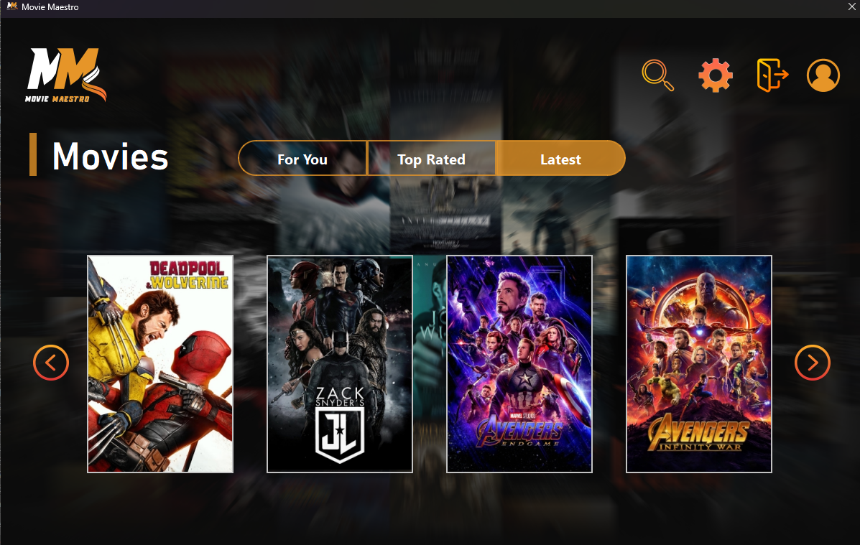
Working Mechanism
User Panel: Homepage
Top Rated
Latest
30

Slide 31
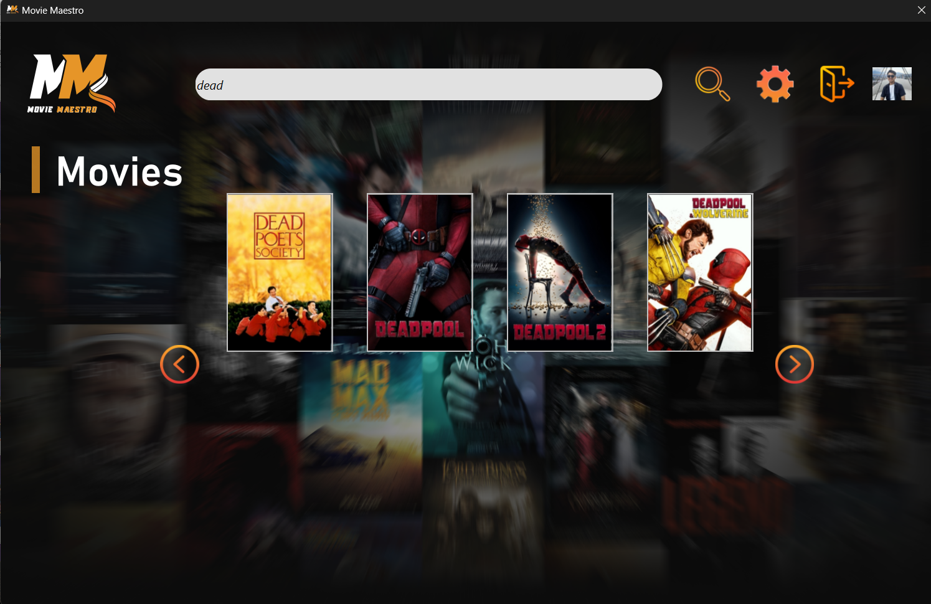
Working Mechanism
User Panel: Homepage
Search Movies
31

Slide 32
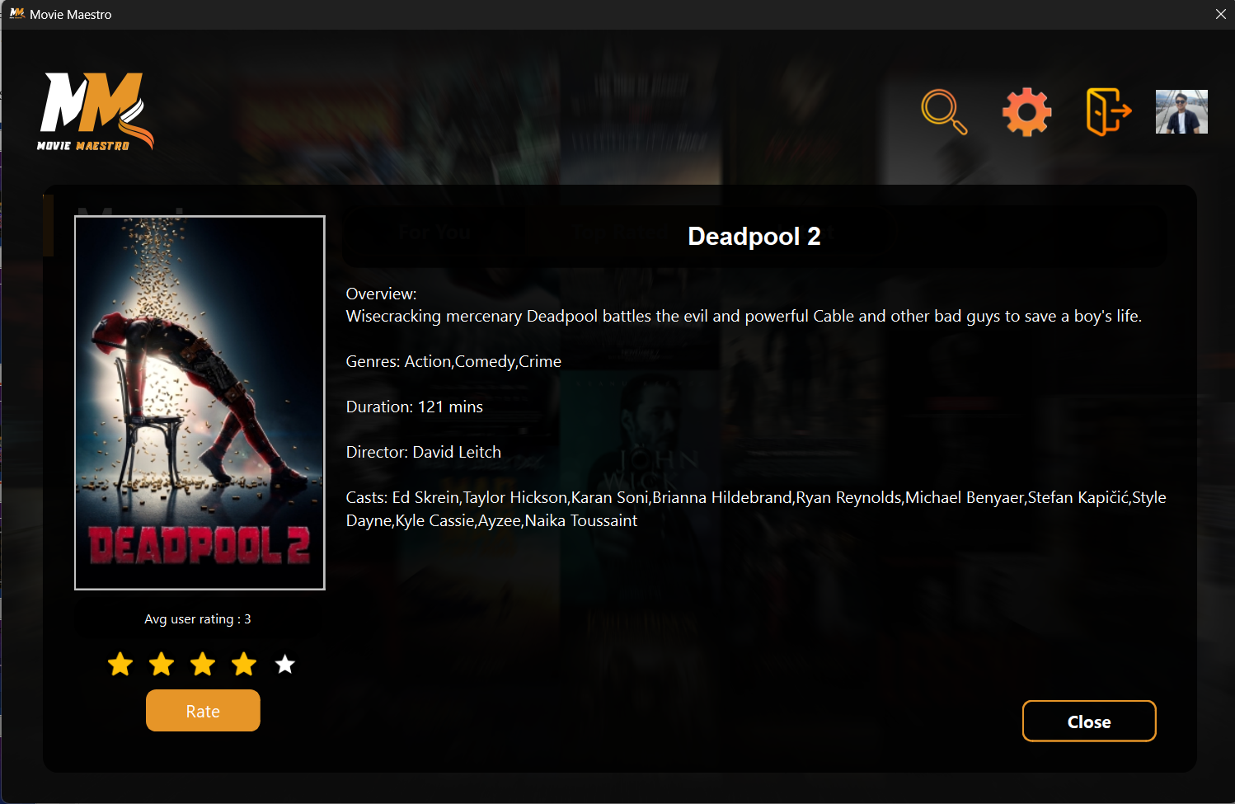
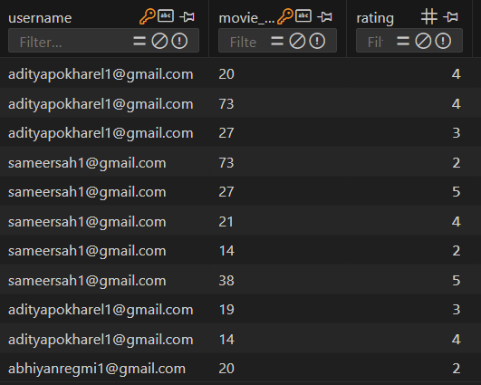
Working Mechanism
User Panel: Homepage
Rate a Movie
32

Slide 33
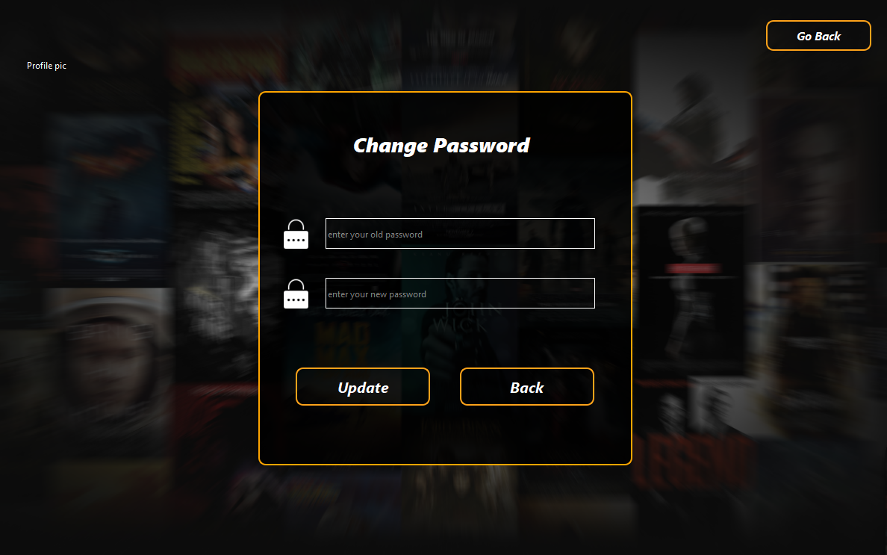
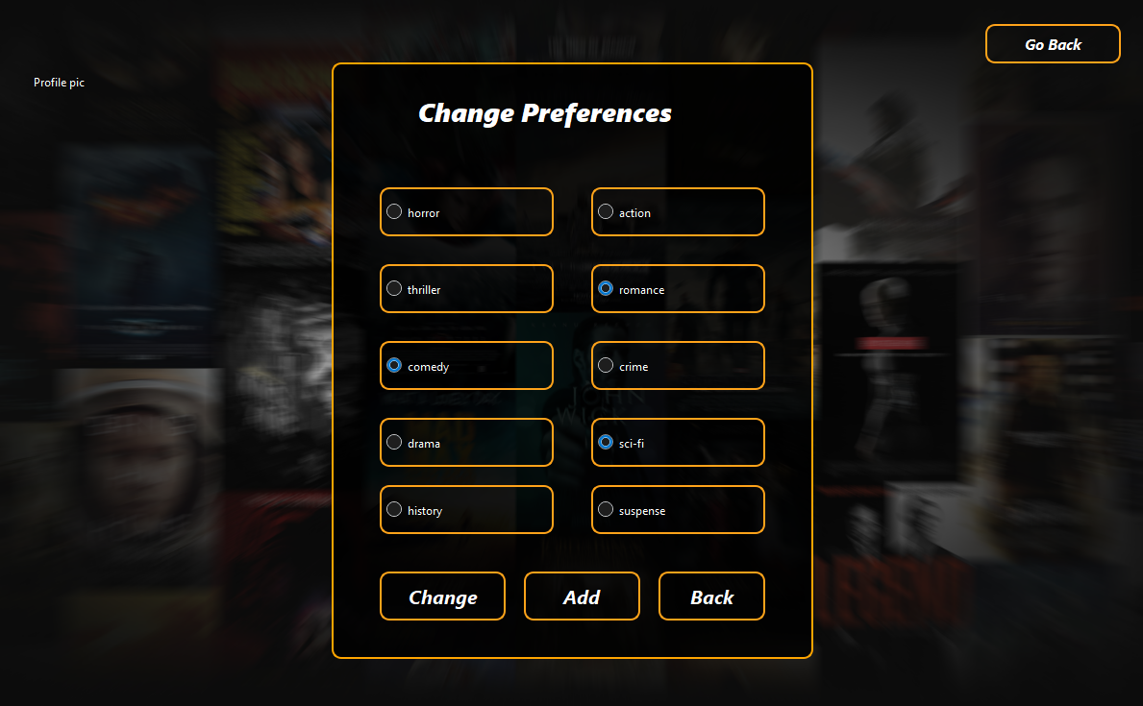
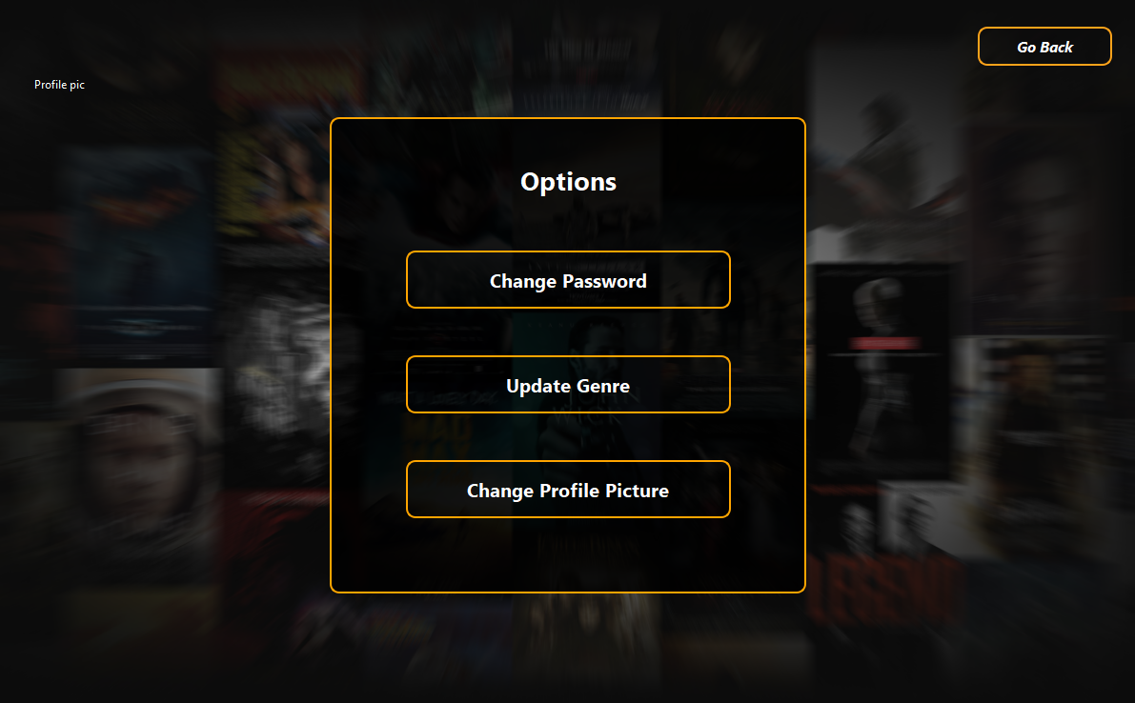
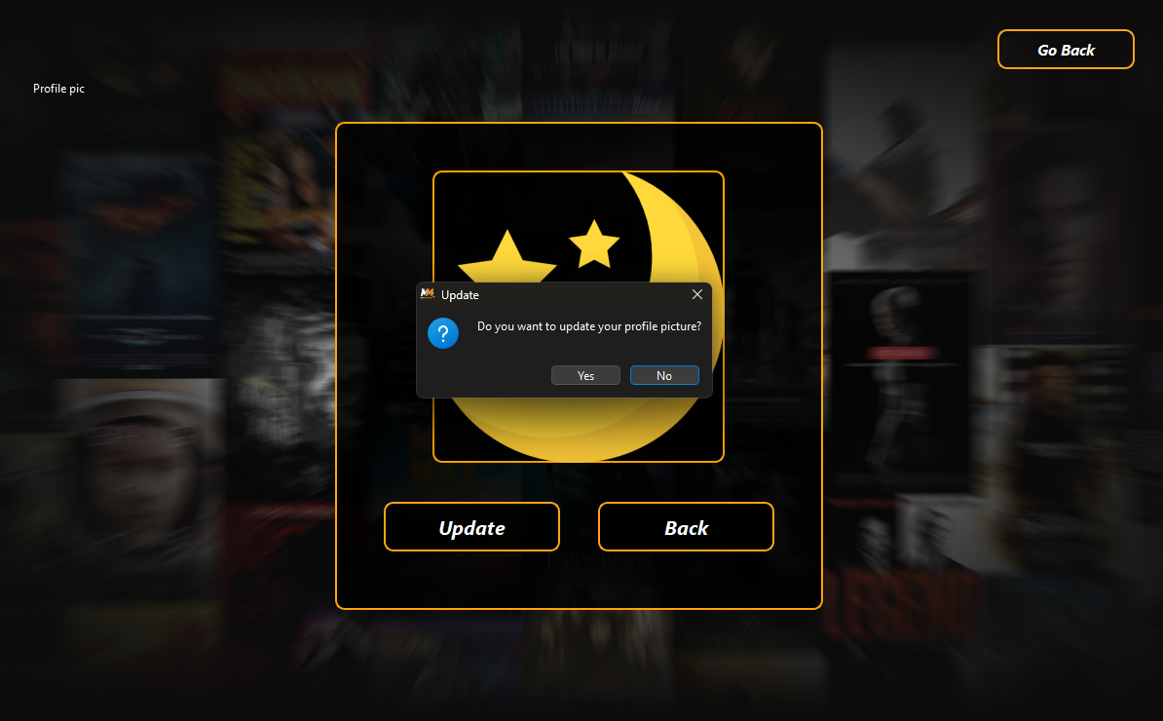
Working Mechanism
Profile Settings
33

Slide 34




Features of Movie Maestro
Search Functionality
Personalized Recommendations
User Profiles
Administrative Controls
34

Slide 35



Limitations
Basic Recommendation Algorithm
Testing
No server
35

Slide 36




FUTURE ENHANCEMENT
Advanced Algorithm
Enhanced Testing
Database Server Implementation
User Feedback Integration
Additional Features
36

Slide 37

Gantt Chart
37

Slide 38
Thank You

